Slide 1

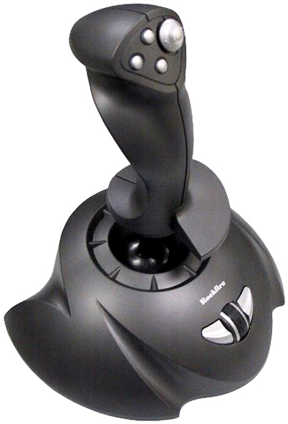
AN INPUT DEVICE. . .
FEATURES. . .
It’s used to control the movement of a cursor across a display screen
It is used to move the characters and symbols that features in computer games
It usually has one or more push-buttons whose state can also be read by the computer

Slide 2
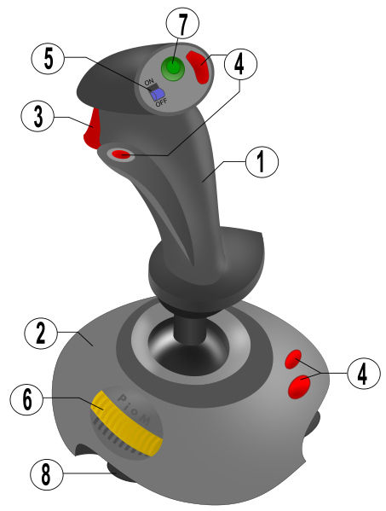

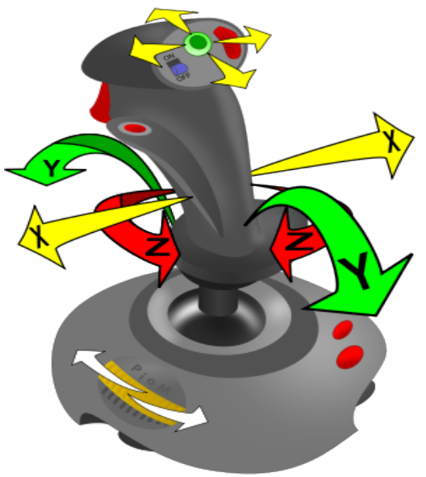
Advantages
It gives the user the feeling of a more realistic action
It moves object in any direction
It is easier to hold than a mouse
Disadvantages
It is limited to certain appliances
Better models offer diagonal movement or better
Control can be a bit crude as the directions in simple joysticks are limited to forward, backwards, left and right.

Slide 3

Features
Special keyboards are defined as those intended to help someone type or enter alphanumeric data more easily.
Examples
Braille , concept , left-handed and virtual/projection keyboards
Advantages and Disadvantages
Disadvantages
If not wireless, keyboards can cause another wire or two to bulk up any workplace or computer-space. They keyboard itself can take up space, too.
Advantages
Its aids the blind to type
It helps them to learn how to type

Slide 4

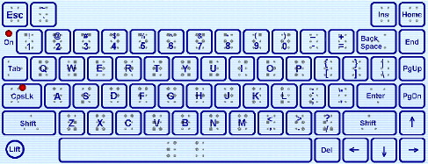
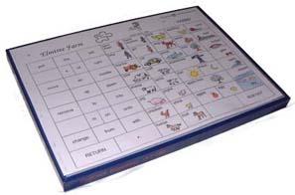
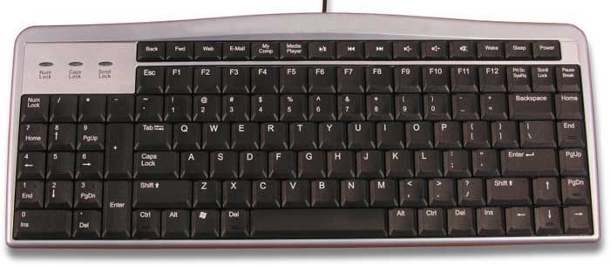
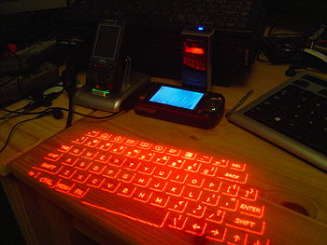
The Smart Card
The interviewee (Shantel Campbell) said that using this is much easier, quicker and simpler to go to an ATM machine rather than going to the bank. No hassle. She uses it at least every week. She felt a sense of independence when she first used it on her own.
Braille Keyboard - Concept Keyboard -
This is used to aid the blind. These are the ones used in
restaurants/supermarket.
Left-handed Keyboard - Virtual/Projection Keyboard -
Used by left handed people. Can be projected and touched on any
surface.

Slide 5

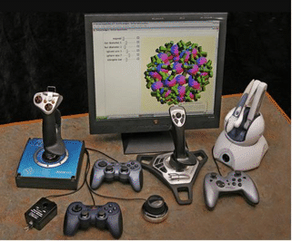

Slide 6
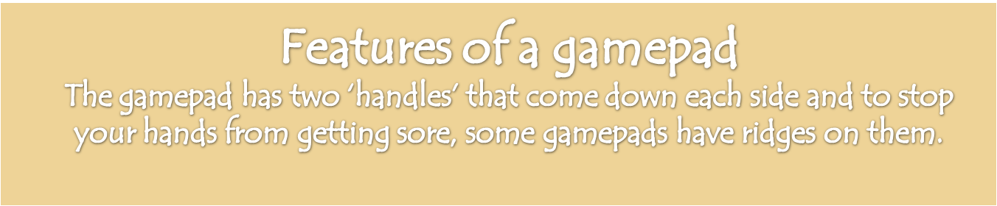
Advantage
  10 easy to hit buttons.
  Software allows you to customize configuration of buttons.
Disadvantage
  Not completely configurable.

Slide 7

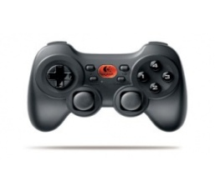
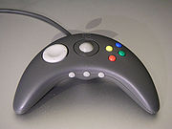
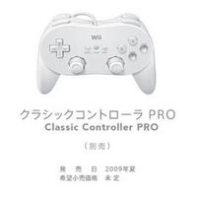


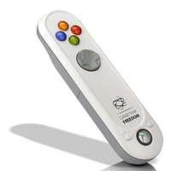

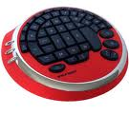

Features
  A BUTTON, when the user presses the button, he/she inputs data into the program. It then takes an action such as firing a missile or reversing the direction of a tank.
  THE DIAL – the rotating of the dial immediately processes the input data and coveys into the program. For example, a goal keeper maybe moved across the face of the goal to intercept a shot.
  A TRACKBALL – is a pointing device which consists of a ball, held by a socket containing sensor to detect a rotation of the ball. The user rolls the ball with the thumb, fingers or the palm of the hand to move a cursor.
Advantages
  It’s not too expensive
  Good design
Disadvantages
  If the program is too slow to react to the button being pressed or the dial being rotated, the game loses it’s appeal.

Slide 8

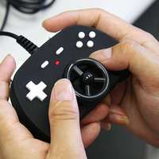

Who uses a game pad ?
  A gamepad is used by someone who has an interest in games and needs to interact with the system.
is it easy to use ? Did you need any special training ?
  Yes, a gamepad is easy to use. Anyone can use a gamepad. To use a gamepad you have to be familiar with the controls. You have to learn how to use it, so you can play.
Is it enjoyable ? Would you recommend someone to use
it ?
  Yes it is if you know how to use it properly. I would recommend it if one wants to play a game on the computer such as a football game or a game that you have to fire missiles.

Slide 9

A Touch Pad/ Track Pad is a pointing device.
It consists of a specialized surface that can translate the motion and position of a users fingers to relative position on the screen.

Slide 10
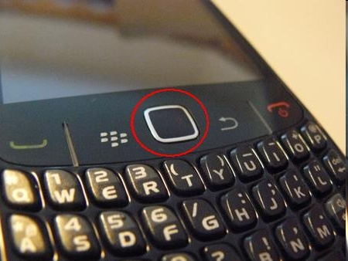

They are common features of Laptops or Portable Computers. Touch Pads are also found on Personal Digital Assistants (PDA’s), phones and some portable media players external units for desktop computers have also been produced. Touchpad includes features, such as Hand Check, Virtual Scrolling, Tap Zones, and Edge Motion.
They are used as substitutes for a mouse and vary in size. They are commonly 5cm by 5cm
Touch Pad / Track Pad found on a Blackberry Curve Cellular Phone
Touch Pad/ Track Pad found on a Laptop or Portable Computer

Slide 11
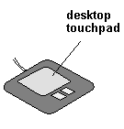
Interview with Candice Neil on her opinion of The Touch Pad/ Track Pad
Candice believes it is easier to travel with a computer that has a built in mouse (track pad) rather than traveling with a mouse itself. It is harder to manipulate and if you use the track pad too much it will wear out or get discolored quickly.
Advantages of Using A Touch Pad/ Track Pad
It is very Reliable -With no moving parts to wear out over time, Touch Pad devices have a related life of over 1 million taps. There is no need to carry around an extra mouse.
It has a High Tolerance to User Abuse- Touch Pad is resistant to moisture, dirt, and surface scratches.
Disadvantage of Using A Touch Pad/ Track Pad
Left and right keys are more difficult to use than in regular USB. mouse.

Slide 12
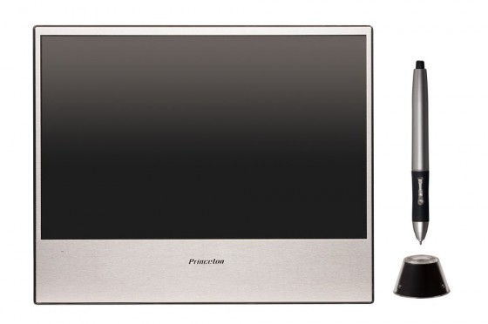
The Touch Screen
Advantages:
The user can select the option very quickly.
The user does not require any training to use it.
Disadvantages:
The System is EXPENSIVE ☹
It is limited to certain applications

Slide 13
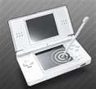
A light sensitive screen that can detect when a person touches it, as well as the area of the screen that was touched.
Uses the human hand as the input medium.
When a finger touches the screen, it blocks out light emitted from that portion of the screen. An option is then chosen from a list of things based on what part of the screen was touched.

Slide 14

A microphone is a form of transducer, which is a device that changes information from one form to another. To input a command by talking into the computer a microphone is used.
Notes:
CHAMICA RICHARDS AND JODI-ANN HUGHES

Slide 15

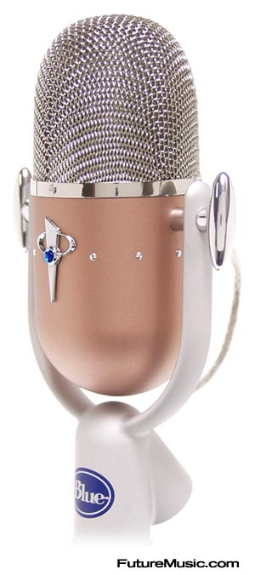
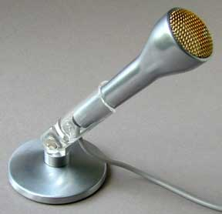
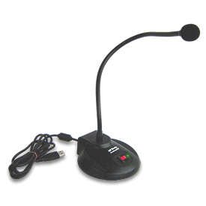
Three features are that it requires no hands, easy to use and easy communication. A professional was spoken to and he says that a mike can malfunction at times and sometimes the circuit board within the mike can be damaged, therefore the mike malfunctions.
A microphone which is used by the computer allows easy communication with different parities globally. Also it requires no chord.

Slide 16


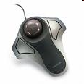

Slide 17

When using the track ball, the need for excessive arm movement in reduced as the ball is operated using the thumb.
In addition the track ball offers greater accuracy in placing the cursor at the anticipated location
Disadvantages:
The ball can get dirty and transfer the dirt to the shafts. This can cause the mouse pointer to move erratically.
Depending on the kind of mouse and the trackball being used could be costly.

Slide 18


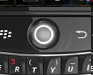
Consist of a spherical shaped ball or a sensor which rolls and turns two shafts, one for each direction

Slide 19

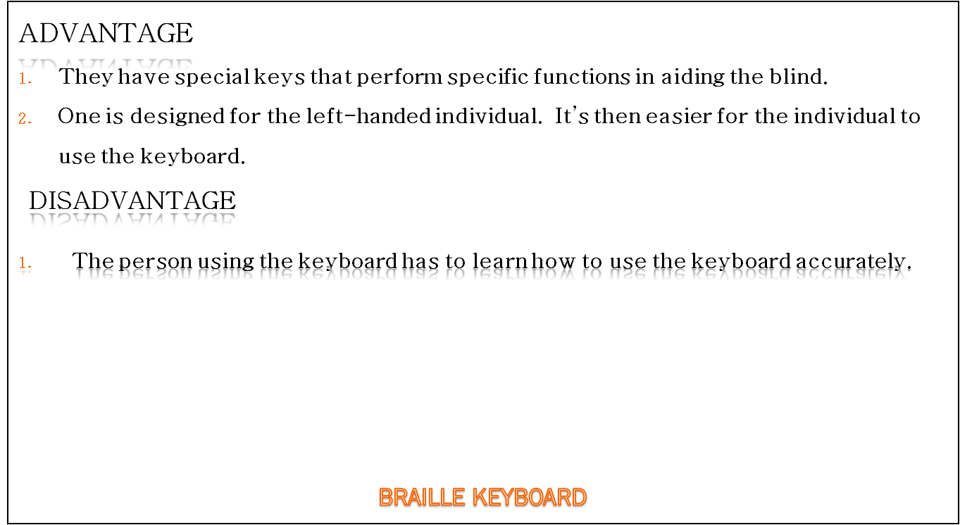


Slide 20

